Slide 1


Project Title – Bank Loan of Customers
Domain : Finance
Datasets: Finance_1.xlsx & Finance_2.xlsx
Dataset Type: Excel Data
Dataset Size: Each Excel file has 39k+ records

Slide 2
Meet the Team
Mangesh Bapurao Patil
Jaydeep Sudhakar Patil
Nikhil Ashok Baviskar
Lalit Bhagwan Sonawane
Vikas Shankar Pawar
Dhanashri Dhanaji Patil
Jithendra H

Slide 3
Overview of this Project :
This project contains two datasets of bank loan of customers.
This project is all about analyzing raw data & converting into clean and meaningful format with the help of visualization tools such as tableau, power bi, excel etc.
We use these dataset which is in the row & column format to create a beautiful dashboard so that we can understand the data easily.
This dataset contains data from 2007 to 2011.
This dataset has 39K+ records.

Slide 4
Tools
Tools that are used for analysis:
Excel
MySQL
Power BI
Tableau

Slide 5
Key Performance Indicator (KPI)
1. Year wise loan amount Stats
2. Grade and sub grade wise revol_bal
3. Total Payment for Verified Status Vs Total Payment for Non-Verified Status
4. State wise and last_credit_pull_d wise loan status
5. Home ownership Vs last payment date stats

Slide 6
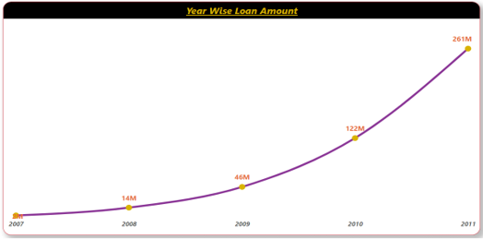
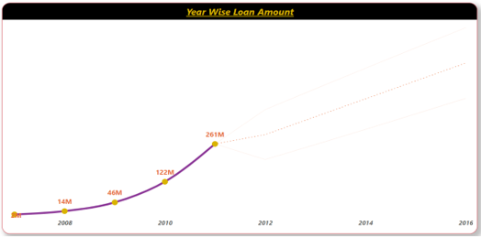
Year wise loan amount Stats
KPI 1
I have use Line Chart with Marker for this KPI.
Above are two charts showing how is loan amount increasing by year wise (2007-2011).
Second chart is showing forecasting of the loan amount of next 5 years which is increasing exponentially (2011-16).

Slide 7
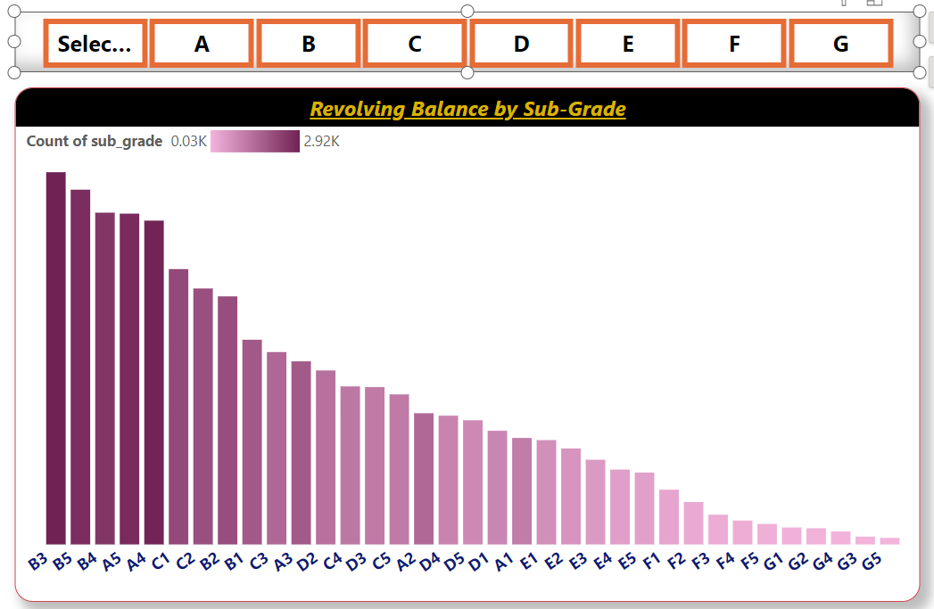
KPI 2 Grade and Sub grade wise Revol_bal
Power BI Desktop
In this Stacked Column Chart, I have shown Grade & Sub-Grade wise Revolving Balance.
Revolving Balance means the balance that carries over from month to month.
With revolving credit , consumer has a line of credit they can keep using & repaying over & over. It is revolve balance on that loan.
In the Grade and Sub-grade wise visuals we have 7 grades with respective sub grades. The visual shows the Grade B with sub grade B3 has the highest number and Grade G with sub grade G5 have the lowest.

Slide 8
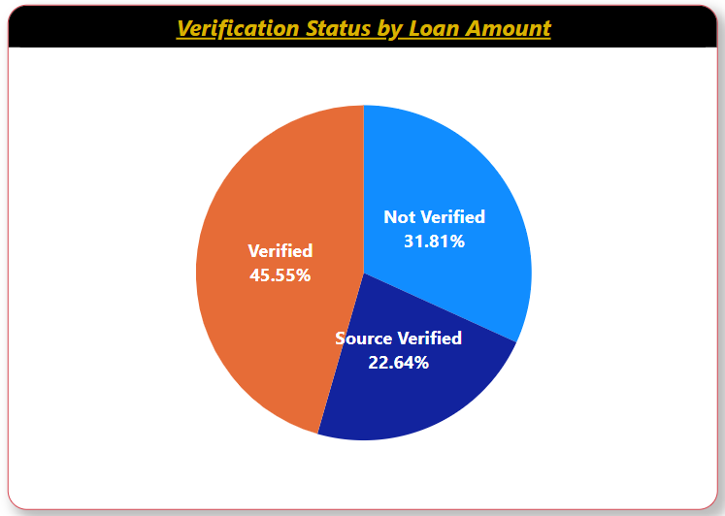
KPI 3 Total Payment for Verified Status Vs Total Payment for Non Verified Status
Power BI Desktop
In this Pie Chart, we have shown verification status of customers by loan amount.
As you can see there are 45% of customers have verified their accounts.
Almost 31% of customers have not verified their account or status.
According to this visual, verified status has the highest percentage.

Slide 9
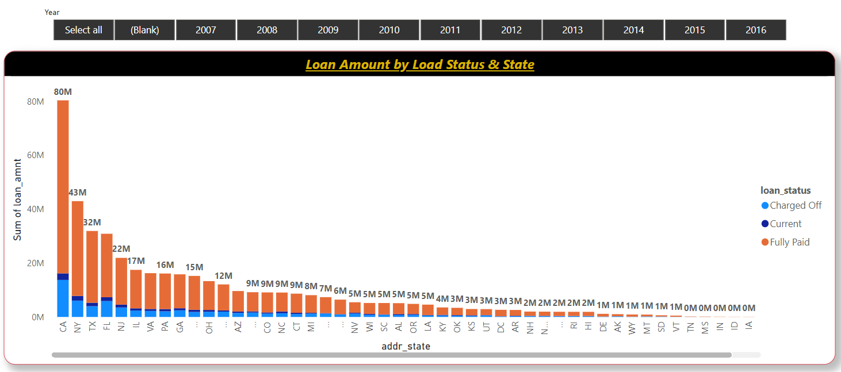
KPI 4 State wise and Month wise loan status
Power BI Desktop
We have used Stacked Column Chart to show State wise & loan status wise Loan Amount.
As you can see, in this chart California (CA) has the maximum amount of fully paid loan amount which is almost $80M.
CA also has maximum amount of charged off loan status compare to other states.
Almost 15% of creditors has written the account off as loss(Charged Off),and their account is closed to future charges.

Slide 10
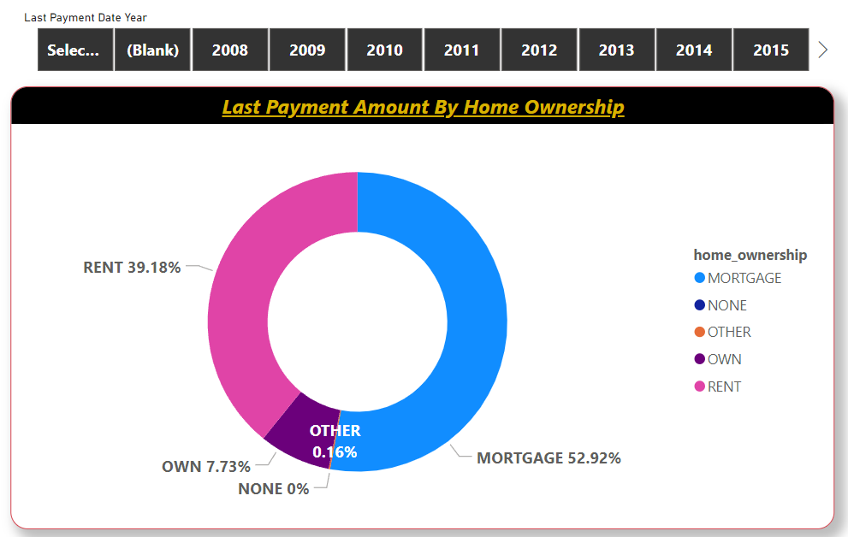
KPI 5 Home ownership Vs last payment date stats
Power BI Desktop
In this Donut chart, we have shown ‘Home Ownership’ respected to last payment amount with the help of slicer of Last payment date year wise.
Approximately 39% of creditors have rented the home over the year.
8% of customers have owned the house.
53% of customers took a loan on property of home.

Slide 11
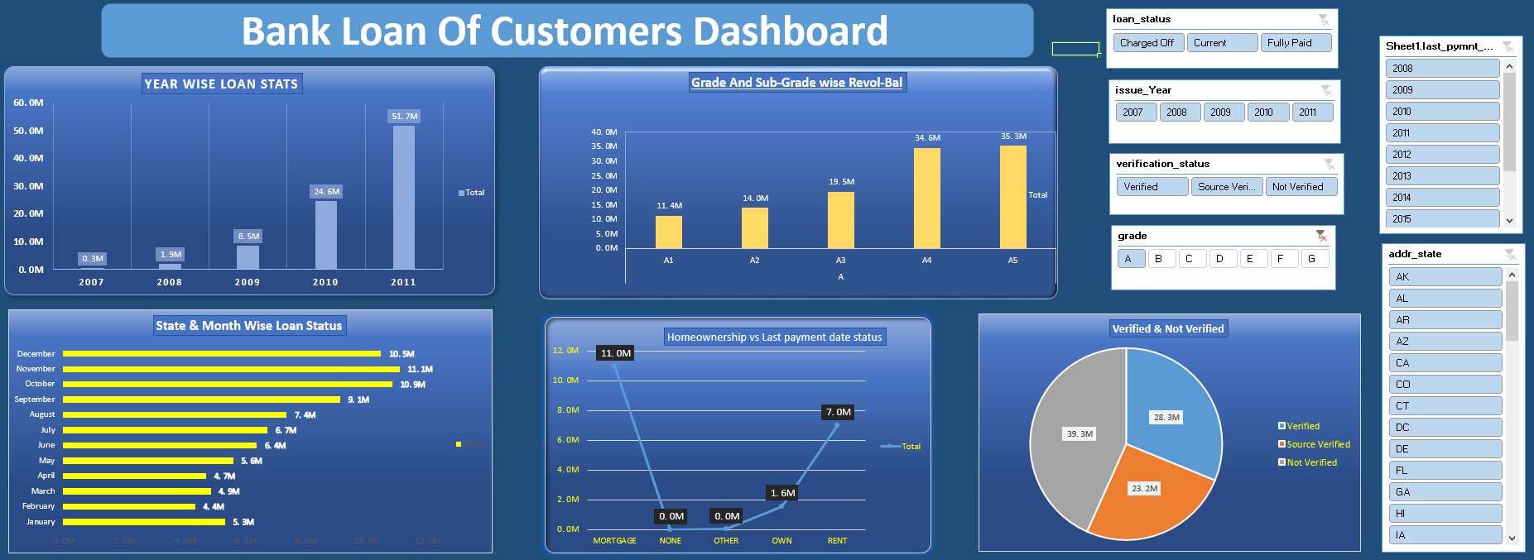
Excel Dashboard

Slide 12
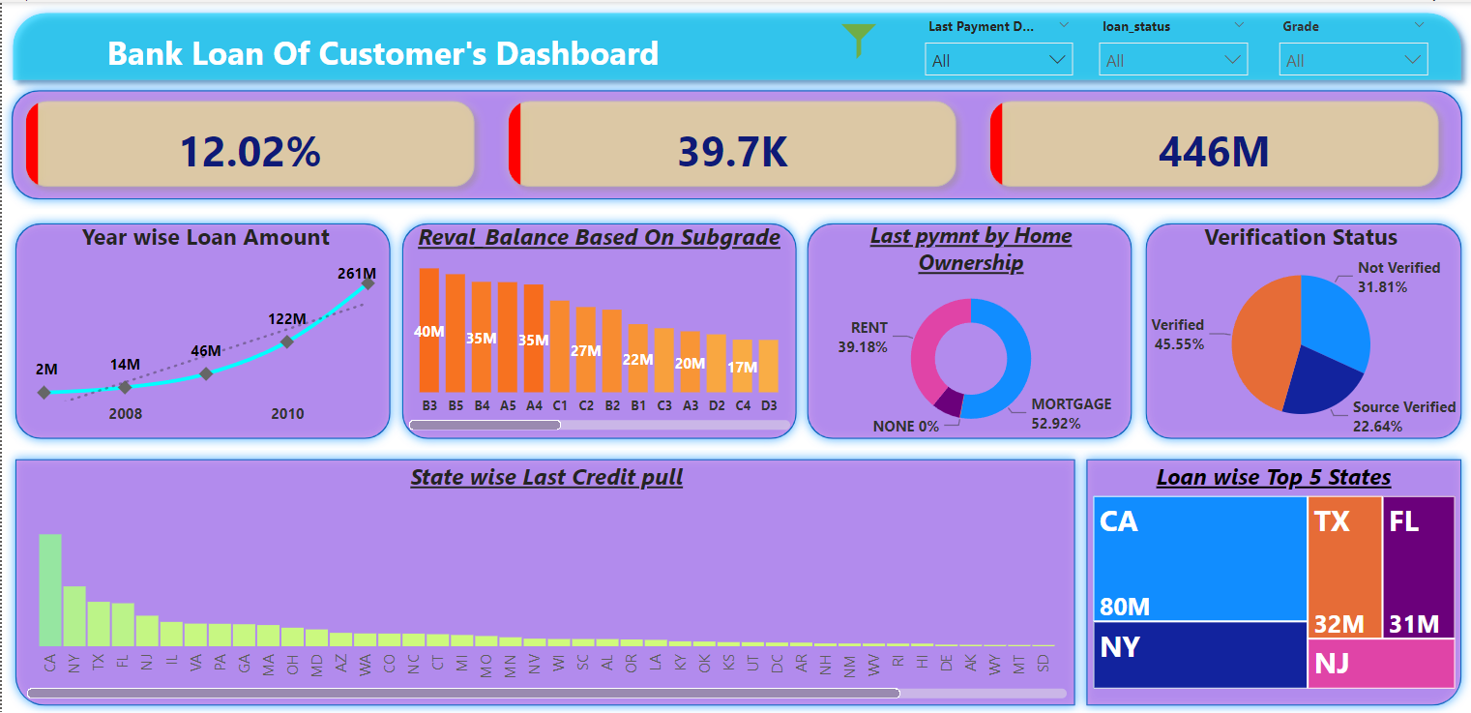
Power BI Dashboard
Power BI Desktop

Slide 13
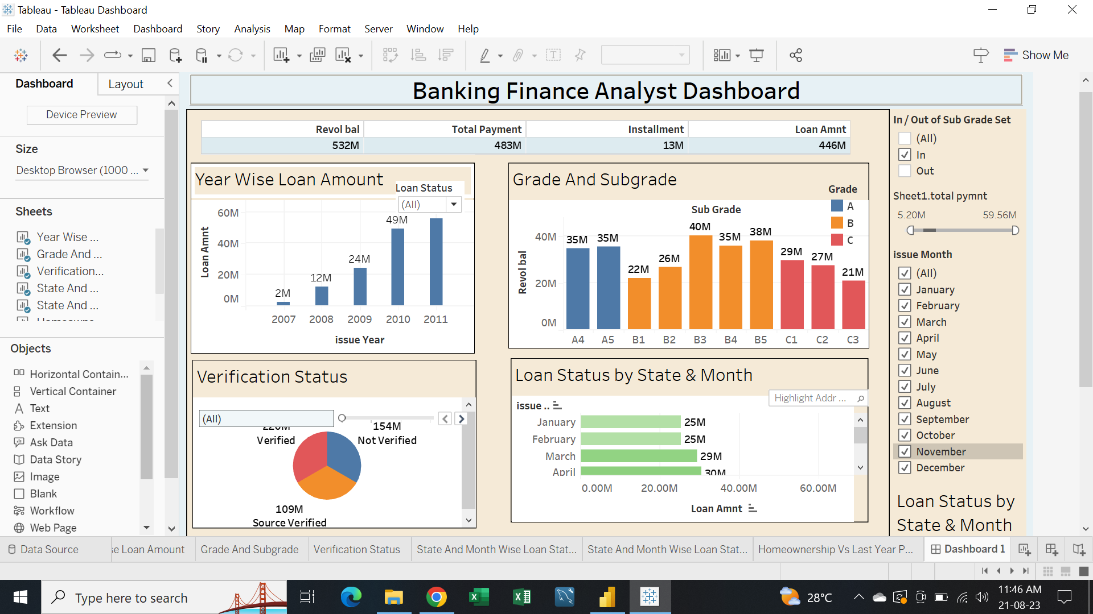
Tableau Dashboard

Slide 14
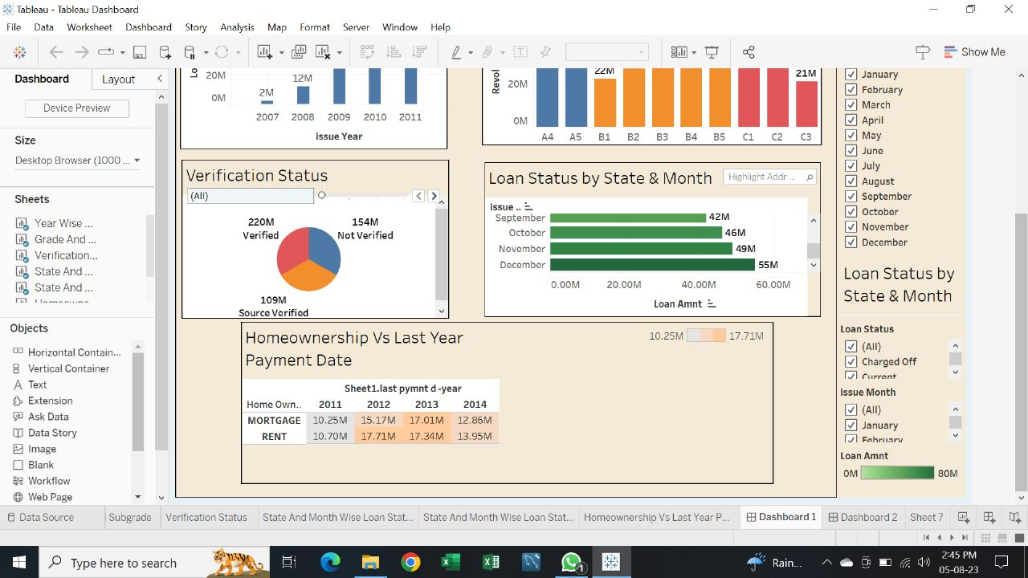
Tableau Dashboard

Slide 15
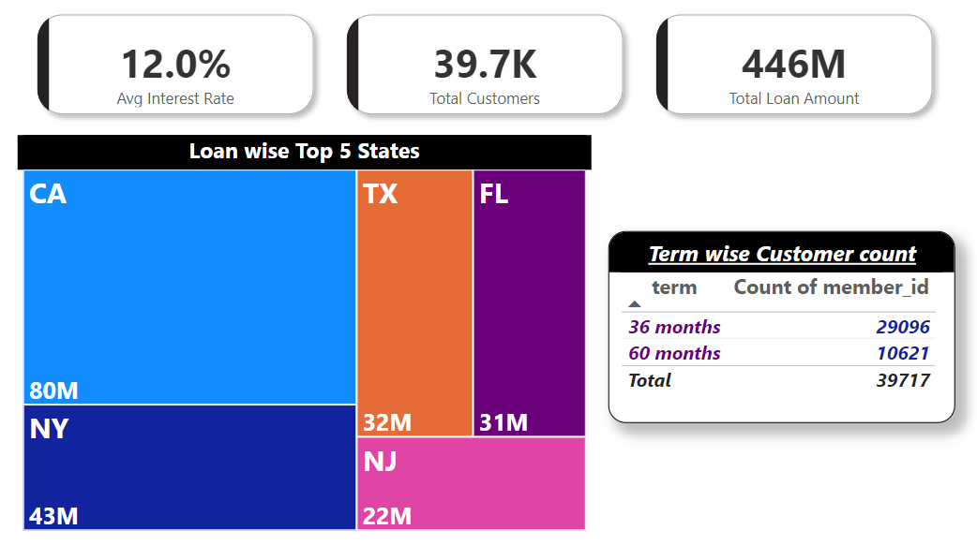
Extra KPIs
Power BI Desktop
Here I have added some extra KPIs by using some PowerBi visuals such as Card, TreeMap & Table.
By using card, I have shown Average interest rate which is approx. 12%.
With the help of TreeMap visual we have shown top 5 states which has maximum loan amount.
California (CA) has maximum $80M. Loan credit.
New York (NY) has second highest loan credit which is $43M.

Slide 16
Conclusion
Power BI Desktop
The bank loan system acts as a crucial base for the financial system as well as the entire economic system of the country.
Here we can see from our analysis that highest numbers of customer fully paid the loan and a small numbers of peoples are paying their loan on time but there are some who’s are defaulters and not paying loan on time.
Loan status of fully paid, Charge off & current is lie on the proper Document Verification, Home Ownership, Mortgage, Rented property etc.
With the help of Excel, SQL, Tableau, Power BI tools we can analysis the data and can make right decision and improve our banking loan process.

Slide 17
Thank you.

